Slide 1

Campus Placement Analysis Presentation using Machine Learning
Performed by:
Payal Ganesh Patil(2203125)
Sayali Deepak Bhosale(2203126)

Slide 2
AGENDA
Machine Learning
Machine Learning Algorithms
Campus Placement Introduction
Problem Statement
Data Representation
Exploratory Data Visualization
Feature Implementation
Feature Engineering
Building Machine Learning Model
Model Prediction
Graphical Representation using Power BI
Conclusion

Slide 3

What Is Machine Learning ?
"Machine learning is an application of artificial intelligence (AI) that provides system the ability to automatically learn and improve from experience without being explicitly programmed. Machine Learning focuses on the development of Computer Programs that can access data and use it learn for themselves."

Slide 4
Machine Learning Algorithm's
SUPERVISED LEARNING ALGORITHMS:
Consist of a target variable which is to be predicted from a given set of predictors. Ex : Regression and Classification
UNSUPERVISED LEARNING ALGORITHM:
Do not have any target variable to predict.
Ex : Clustering and Association
REINFORCEMENT LEARNING ALGORITHM:
It is about learning the optimal behavior in an environment to obtain maximum reward.

Slide 5

Campus Placement Introduction
Campus placement is a program conducted within educational institutes or in a common place to provide jobs to students pursuing or in the final stage of completing the educational program.

Slide 6
Problem Statement
This data set consists of Placement data of students in a XYZ campus. It includes secondary and higher secondary school percentage and specialization. It also includes degree specialization, type and Work experience and salary offers to the placed students

Slide 7
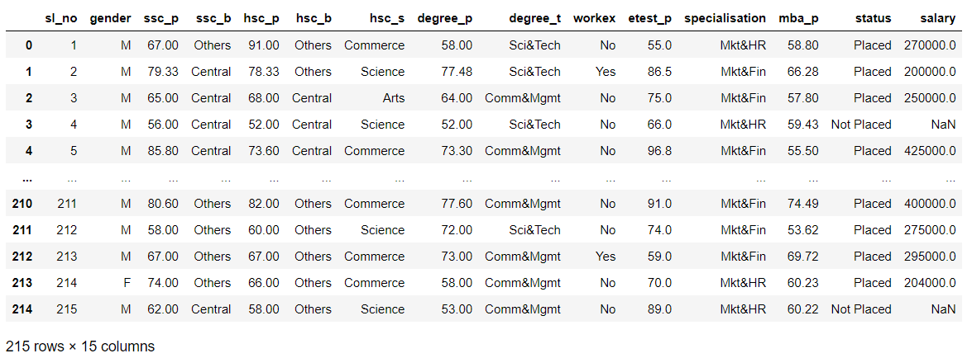
Data Representation
A CSV file consisting of dataset is read using Pandas and after cleaning this dataset EDA is drawn using Seaborn ,Matplotlib libraries in Machine Learning.

Slide 8
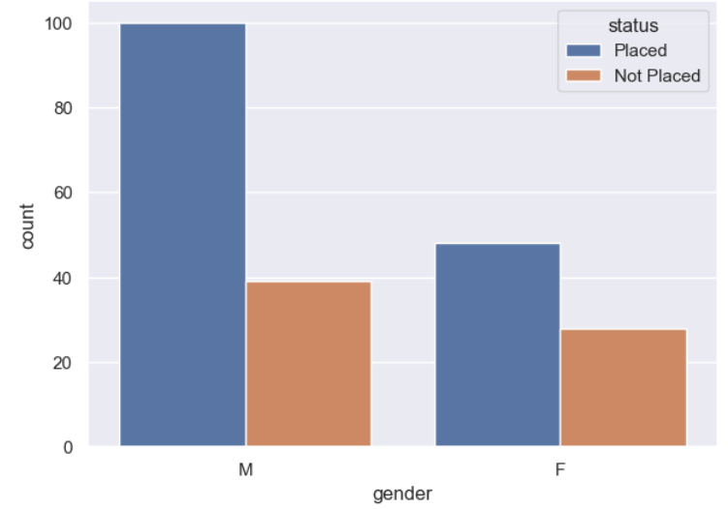
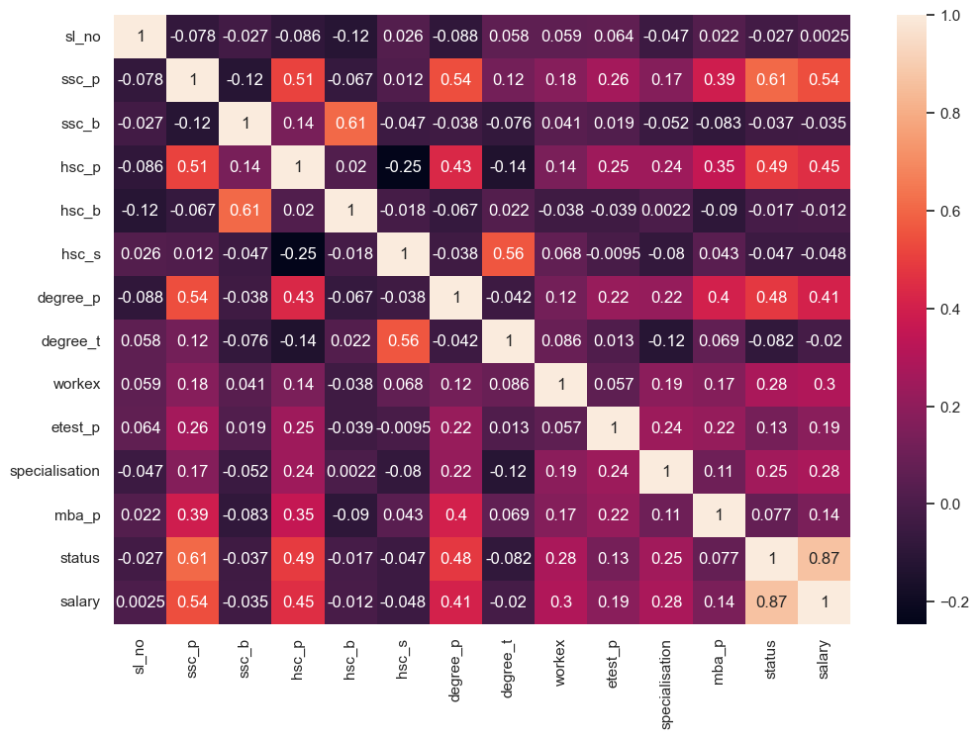
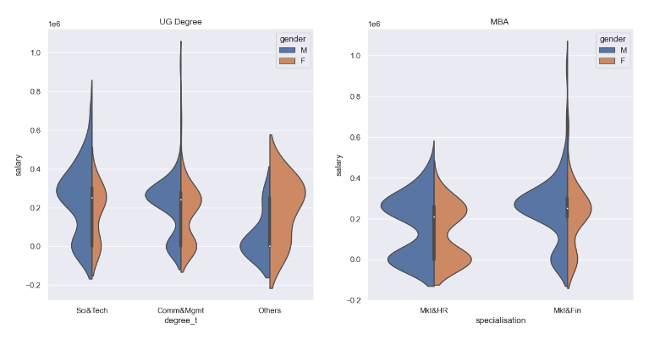
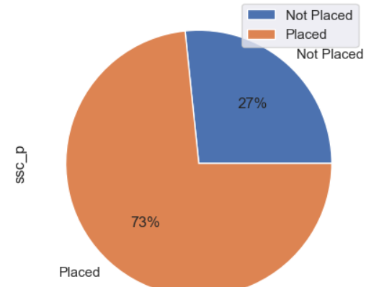
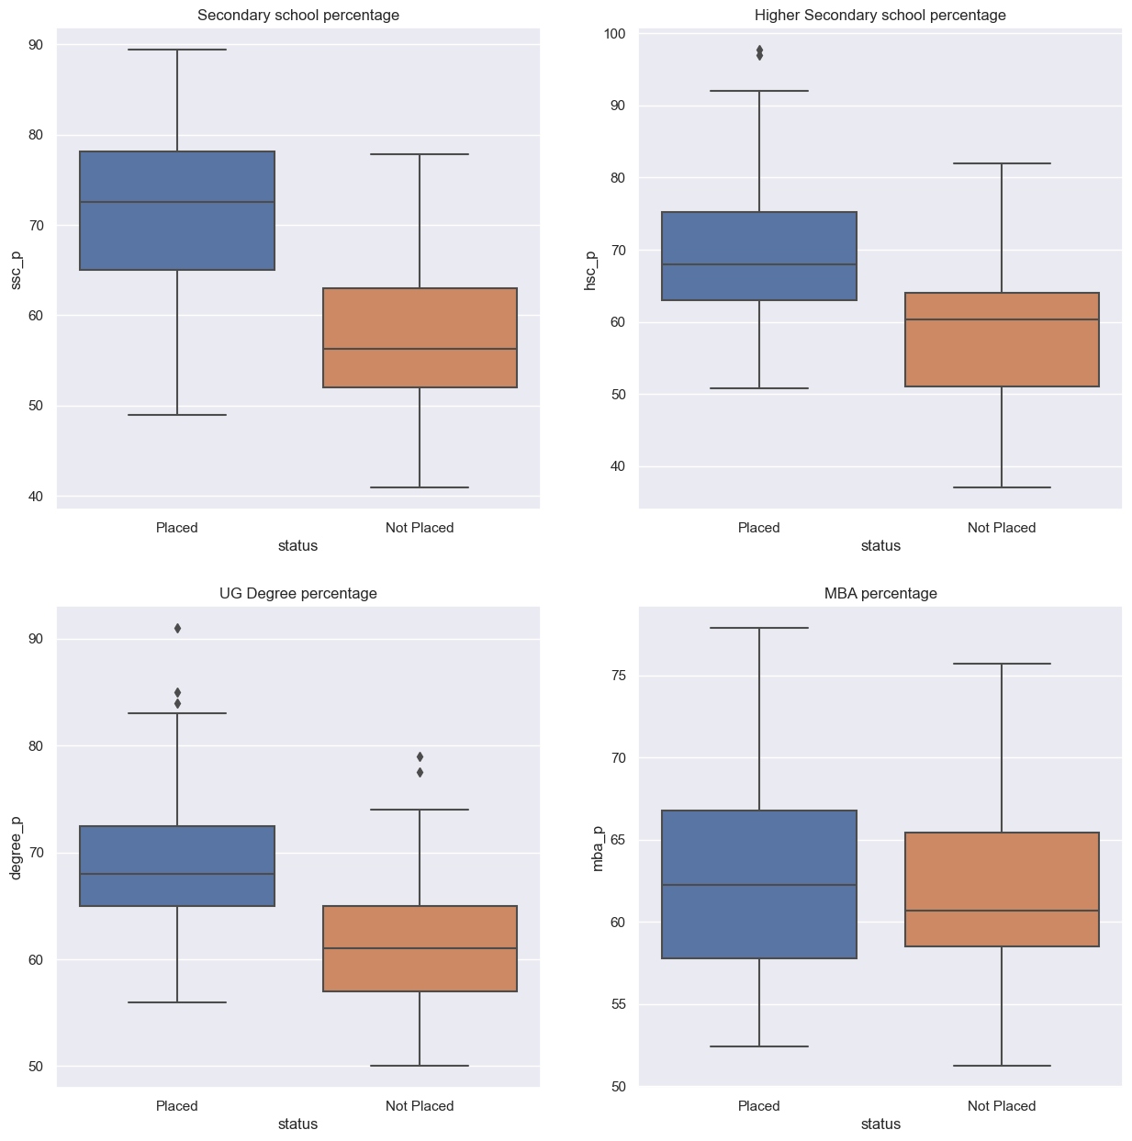
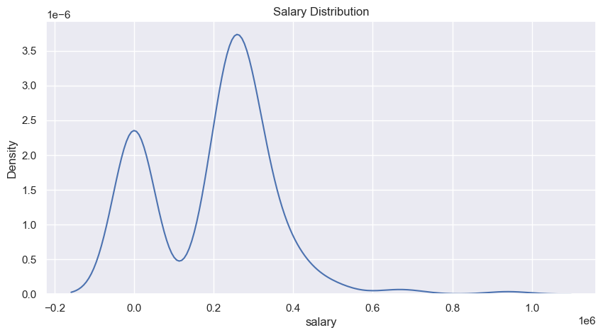
Exploratory Data Visualization

Slide 9
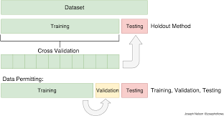
Feature Implementation
Methods and Data
Training set: Testing set:
A subset to train a model. A subset to test the trained model.

Slide 10
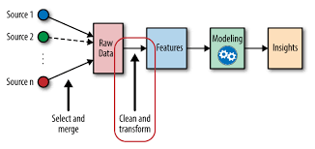
Feature Engineering
Feature engineering refers to manipulation — addition, deletion, combination, mutation — of your data set to improve machine learning model training, leading to better performance and greater accuracy.

Slide 11
Building Machine Learning Model
STEP 1: Importing Libraries .
STEP 2: split the data into train and test model.
STEP 3: Train the ML model using Classification algorithms
Logistic Regression, Random Forest ,K NN, SVM, Navies Bayes.
STEP 4: Select the best fit model with higher Accuracy score after prediction .
STEP 5: Cross Validation is done on testing data set.
STEP 6: Conclusion given from the best fit model.

Slide 12
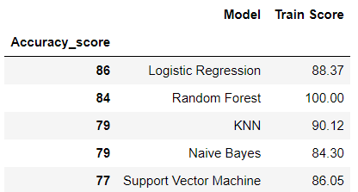
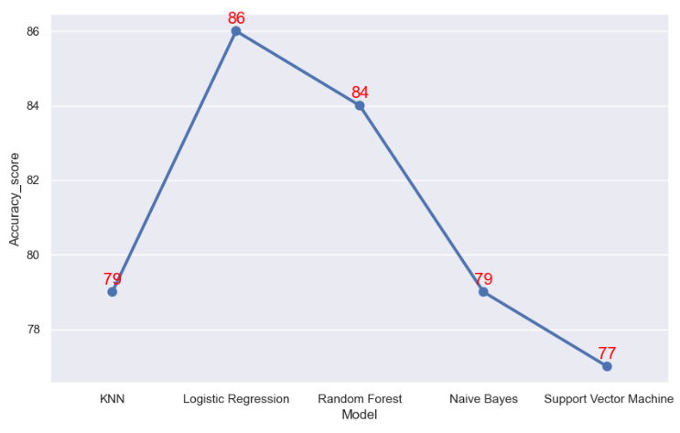
Model Prediction :
From this diagram we can see that Logistic Regression is the Best Fit Model for the trained dataset with high accuracy score.
And for further prediction on test dataset we are going to use Logistic Regression.

Slide 13
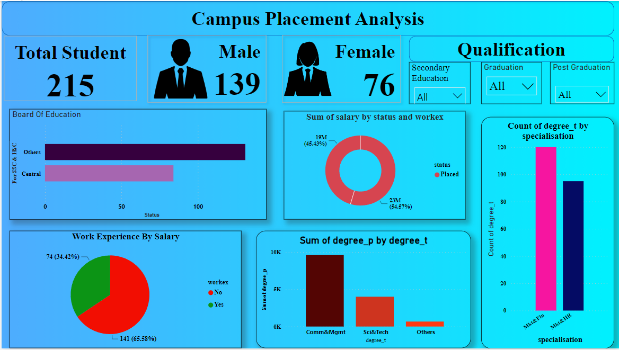
Graphical Representation using Power BI

Slide 14
Conclusion:
From the analysis report on Campus Placement dataset here are my following conclusions
Board doesn't matter in placements.
There are no gender discrimination while hiring, but during analysis higher packages were given to male .
Commerce and Science degree students are preferred by companies which is obvious. Students who opted for Others have very low placement chance.
Educational percentages are highly influential for a candidate to get placed
BUT These percentages don't have any influence over their salary
Work Experience is a clear indicator as more work experience results in higher CTC jobs.
THANK YOU

